Slide 1
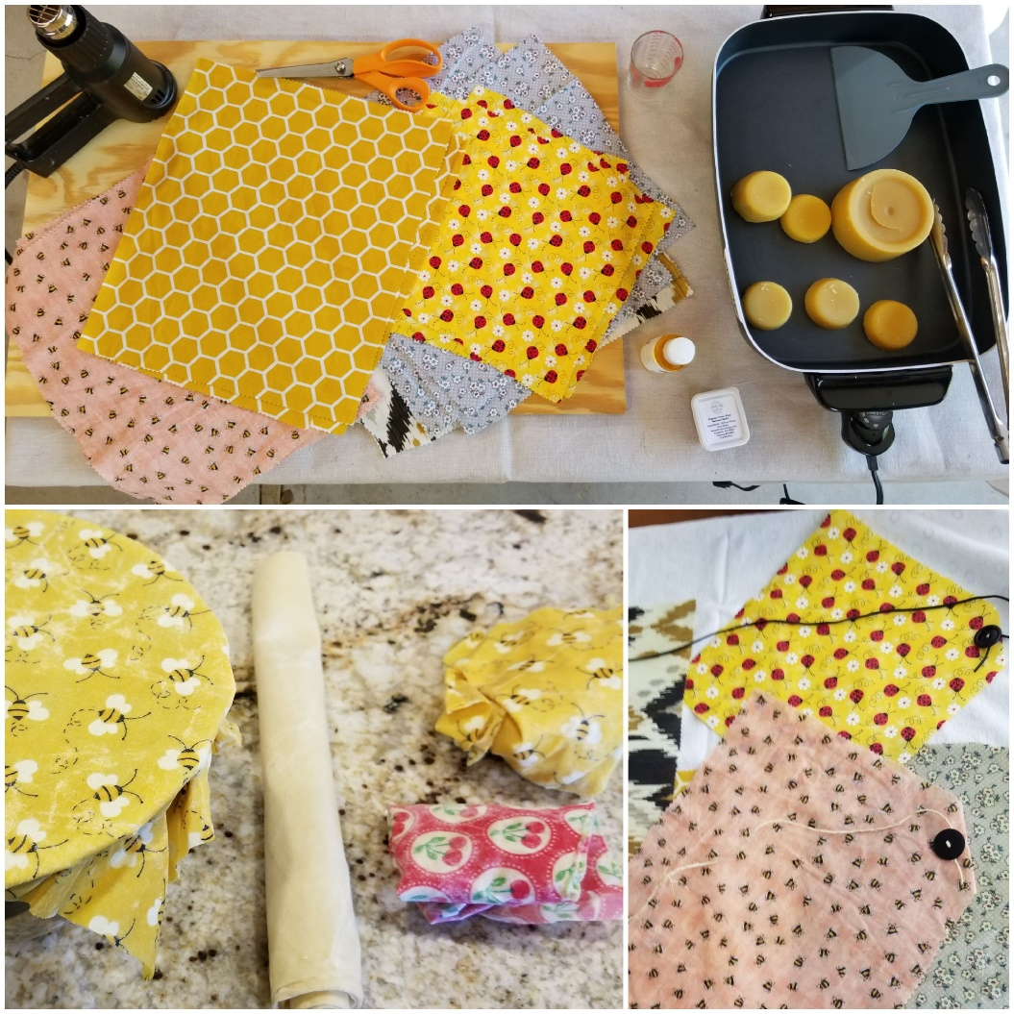
Beeswax Food Wraps DIY
Peter Underwood peter@jrsweb.com

Slide 2
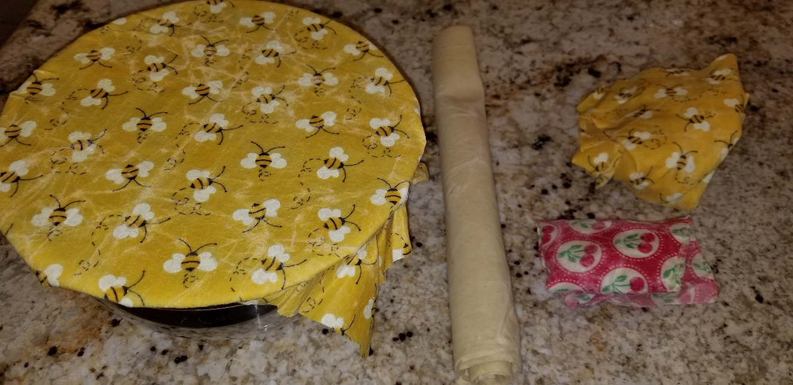
What is waxed cloth?
Waxed cloth is simply fabric coated or impregnated with wax and possibly other waterproofing substances
Waxed cloth has been used for centuries to store food, to waterproof clothing, and to coat boat sails

Slide 3
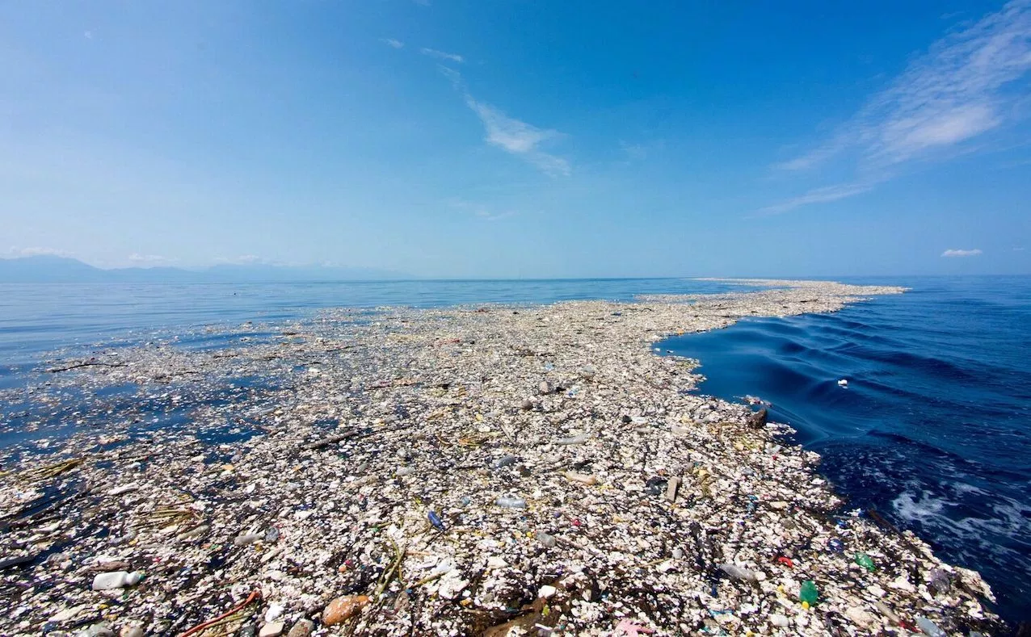
Waxed cloth resurgence
Oceans are filling up with plastic
Waxed cloth seen as replacement for plastic wrap, plastic bags, and aluminum foil
Reusable, washable, renewable, compostable

Slide 4
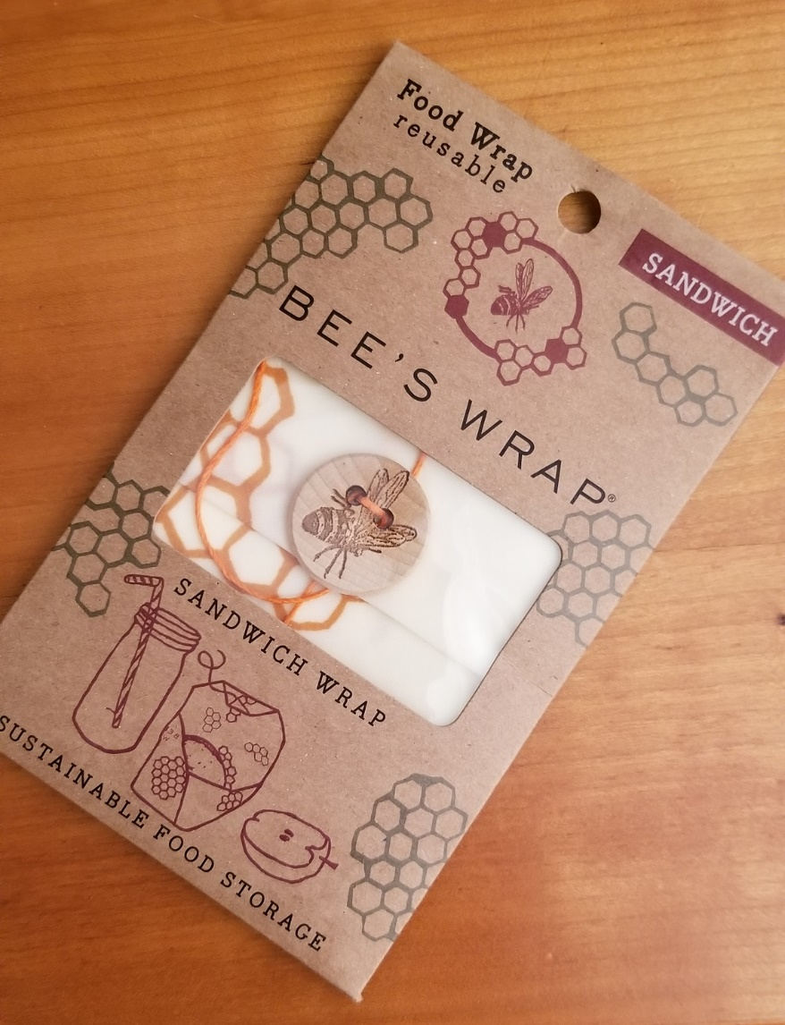
Commercial Wraps
Grocery Stores
Farmer’s Markets
Online
Expensive?

Slide 5
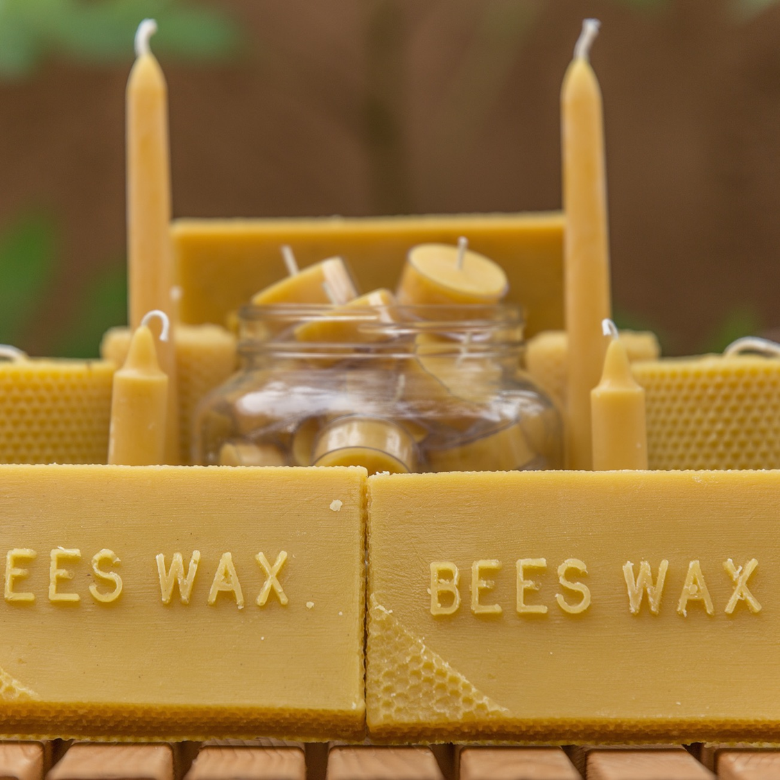
Waxed cloth DIY
One of the easiest DIY projects using products from the hive
Can use your own beeswax from excess comb, wax cappings, old frames, crush and strain leftovers
Buy beeswax blocks at farmers markets or your local beekeeper

Slide 6
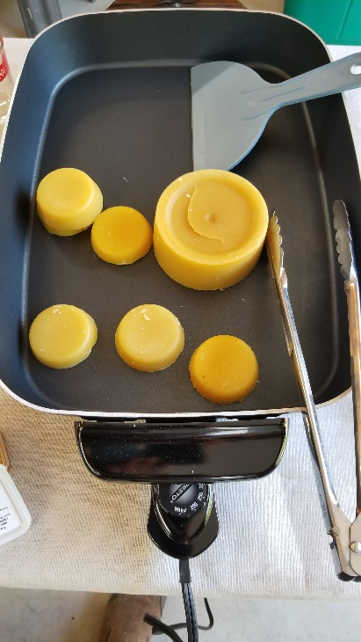
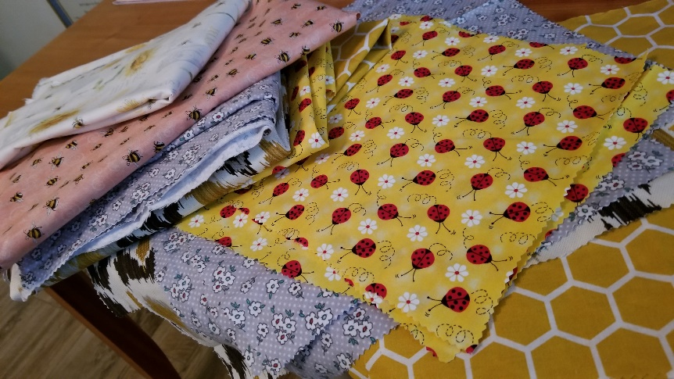
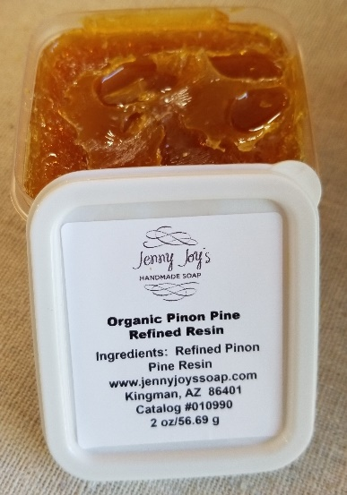
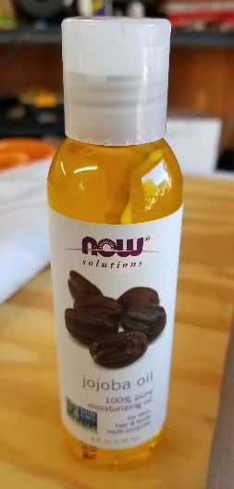
What do you need?
Beeswax (cleaned) 1-2 oz. per 12” x 16” cloth
Flexibility and cling enhancers are useful: Jojoba oil, pine resin
Cotton cloth
Heat gun (hair dryer might work)
Heat source to melt wax
Electric skillet
Crock pot
Microwave
Oven, stove top (double boiler)
Solar melter

Slide 7
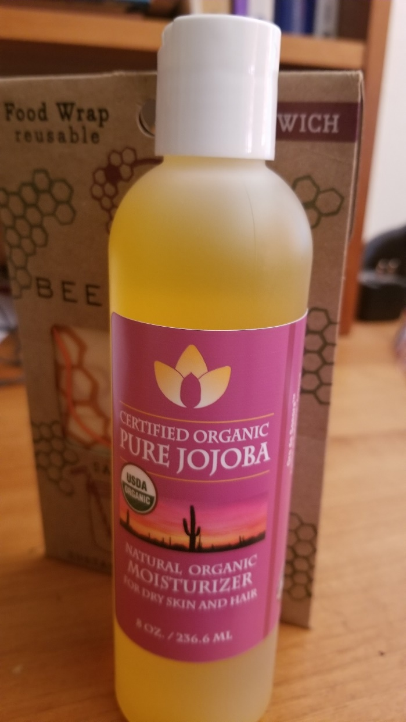
Miraculous JoJoba Oil
Local plant!!
Chemically slow to oxidize
5-year shelf life
No odor
Could use any plant oil

Slide 8
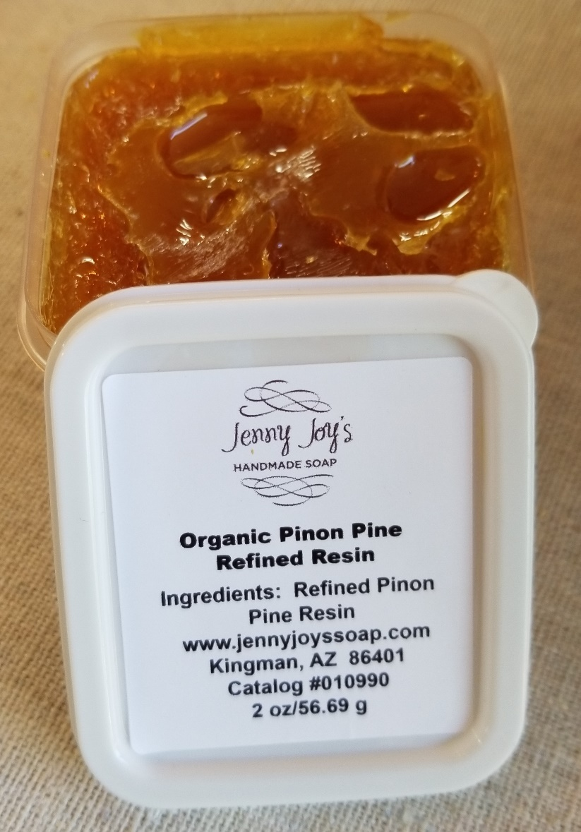
Pine Resin
Adds useful tackiness
NOT powdered Pine Rosin
Imparts strong pine scent
Local product (jennyjoyssoap.com)
Propolis?

Slide 9
Bee Careful!
Wax is quite flammable (flash point 400 ⁰F)
Hot wax can easily burn skin
Electric skillet has many merits
Can control temperature easily
Wax has little potential to contact heating element
Cheap (craigslist, 2nd hand stores)
Doesn’t ruin marriages
No big mess of kitchen, cookie sheets, oven, microwave, house . . .
Can use for other wax melting projects (lip balm, candles, wax processing)

Slide 10
Wax cloth DIY process
Any 100% cotton or hemp cloth works well
Quilting cotton prints (lots of honey bee or insect patterns)
I like light cotton upholstery fabric or very light cotton flannel
You don’t HAVE to use
Honey bee themed fabrics, but, . . . .

Slide 11
Wax cloth DIY process
Cut cloth into sizes you prefer
Pinking the edges decreases fraying
8” x 8” works well for cheese and small items
10” x 12” sandwiches
14” x 16” for bowl covers, larger items
Buttons with tie string can be added later if desired

Slide 12
Melt the wax & oil (175 ⁰F)
Adding a little bit of oil really helps with flexibility & ability to mold to the shape
Jojoba oil has a long shelf life (doesn’t go rancid quickly)
Pine resin also helps with flexibility and aids in cloth clinging to itself and to bowls (people like or dislike the pine scent)
Peter’s formulas: 1 lb. wax; 45-60 mL (1.5-2 oz) oil 1 lb. wax; 30 mL oil; 1 oz pine resin

Slide 13
Soak cloth in wax

Slide 14
Other waxing methods
Melted wax can be painted onto cloth
Will require heat gun to work wax into cloth
Grated wax placed on cloth & melted in oven or solar melter
Use very low heat (<200 degrees)
Place cloth on parchment covered cookie sheet
Will require heat gun to even out wax
Be careful of oven fires

Slide 15
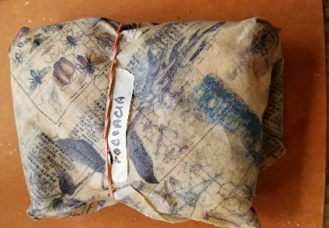
Remove excess wax
Place waxed cloth on top of next cloth to be waxed
Excess wax will be soaked up by 2nd cloth
Use heat gun to work excess wax into cloth
Wipe away excess wax with another cloth to be waxed
Set on cardboard or scrap cloth to dry
… never buy plastic wrap again!

Slide 16
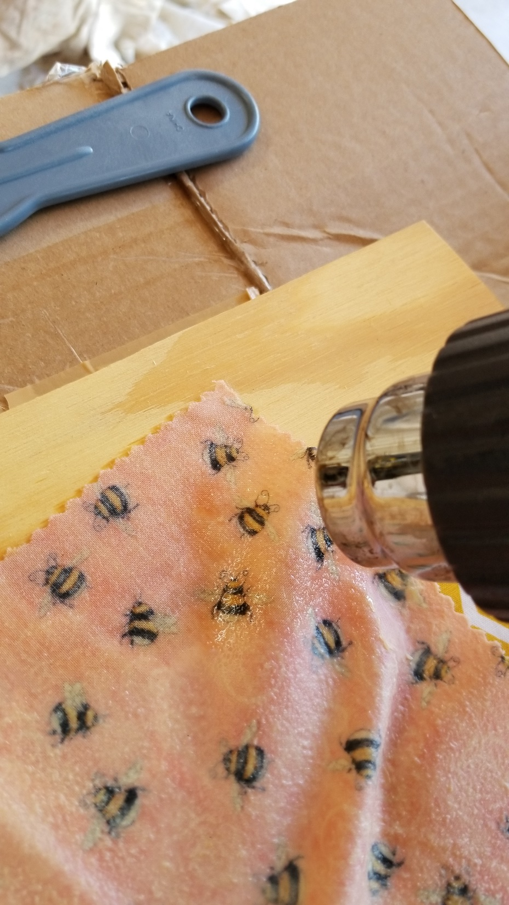
Removing excess wax with heat gun

Slide 17
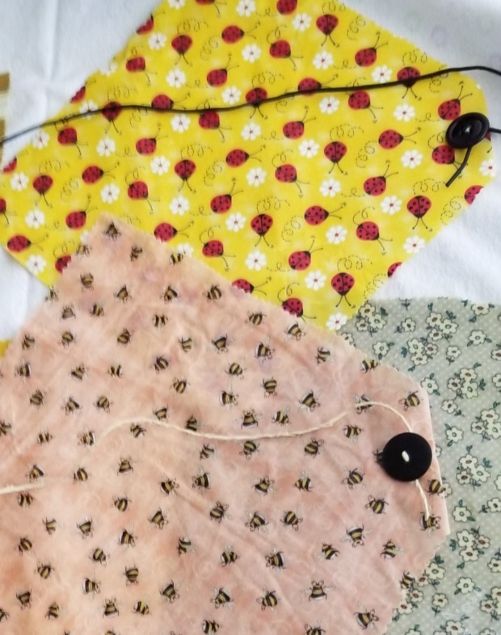
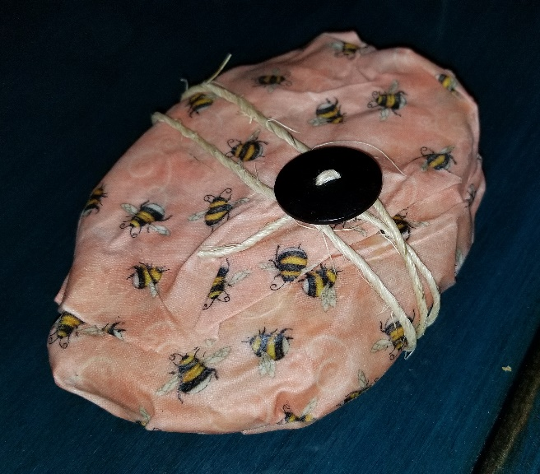
Use of cloth
Heat from your hands helps mold the cloth to itself or to item being stored
Rubber band or string can help keep cloth in place
Cloth-stored food can be kept in freezer (wax may flake off)
Wash with sponge/rag using luke-warm soapy water
Don’t store raw meat or fish
Cloth may be re-waxed or composted

Slide 18
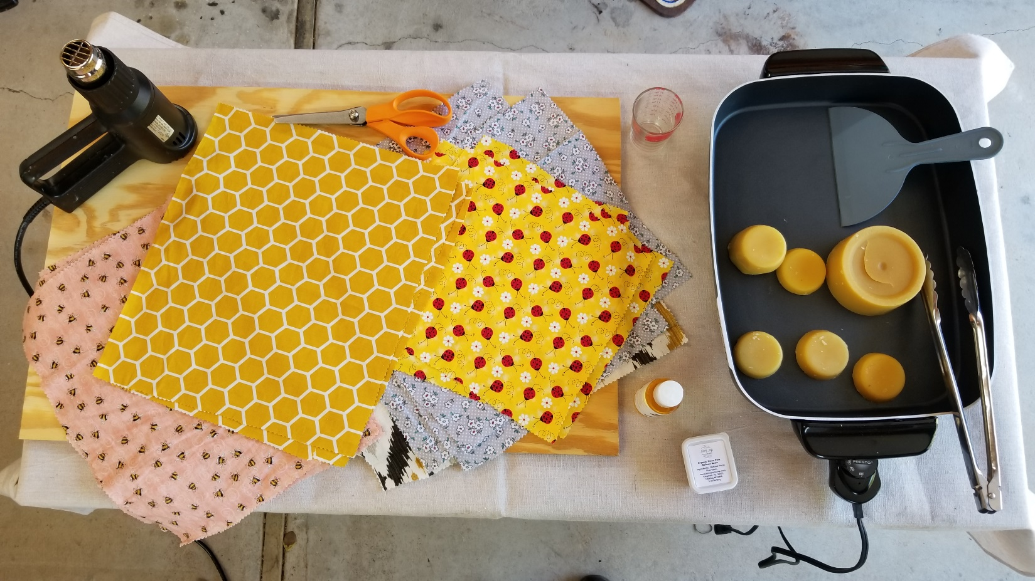
Demonstration

